Slide 1
Extended GNSS
ASE 372N
Matthew Cullen Self
December 9, 2016

Slide 2
Feasibility of Using GPS in Space
Will my GPS receiver work on the moon?

Slide 3
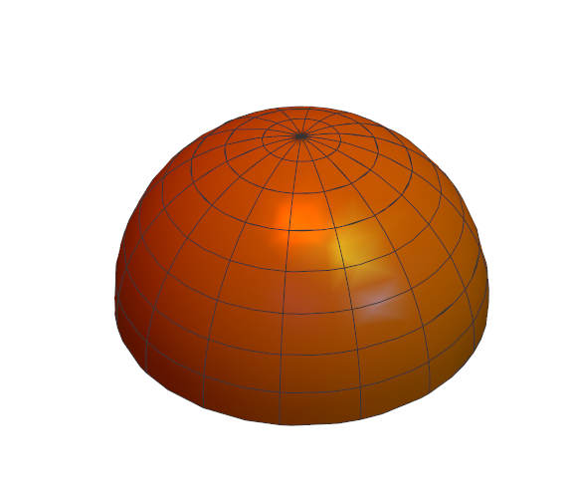
How GNSS SVs Broadcast
Antenna pointed at Earth
Emit a Hemisphere of Radio Waves
Most power in “Main Lobe”
“Side Lobes” still have some power
Notes:
Maybe add hemisphere graphic, or emitted power from SSV #19, cite GNSS satellite geometry and attitude models

Slide 4
Baseline
Classified Geosynchronous Satellite (42,164 km)
AMSAT-Oscar-40 (58,800 km)
GIOVE-A SGR-GEO (23,200 km)
MMS (76,000 km)
Notes:
Geosync – since 1990, not published how many SV tracked, entire signal is downlinked to process, included in nav model
Ao40 – launched 2000, not very powerful tracking, max of 2 sats tracked
GIOVE – launched 2005, Galileo test sat, onboard rx was able to produce nav sols with vdop 50-100m, hdop 10-15m (
MMS – launched 2015, has Navigator receiver - tracked at least 4 sats all the time
Cite: ssv, gps2000 [kronman], ao40, gps receiver dem 2007

Slide 5
Process
Can I test without going to the moon?

Slide 6
Quality of the Receiver
Antenna
Noise
Gain
Tracking Algorithm

Slide 7


Governing Equations

Slide 8
Data Sources
Gain patterns of GPS Block IIR & IIR(M) SVs (Lockheed Martin)
GNSS Attitude Models (Montenbruck)
Notes:
Given in terms of offbore sight theta, and clock angle phi
Cite GPS Block… Marquis
Cite montenbruck

Slide 9
Assumptions
All SVs are similar
SVs nominally emit 30 dBW of power
Receiver has uniform gain

Slide 10
Results

Slide 11
Single SV

Slide 12
Many SVs

Slide 13
DOP

Slide 14
AO40 Replication

Slide 15
Conclusions

Slide 16
Observability

Slide 17
Possible Reach

Slide 18

Future Work
Implement more SVs, L2
Better RX model
$H′=\frac{∂C/N_{0}}{∂x}{\left.​\right|}_{x=\overline{x}}$

